Slide 1

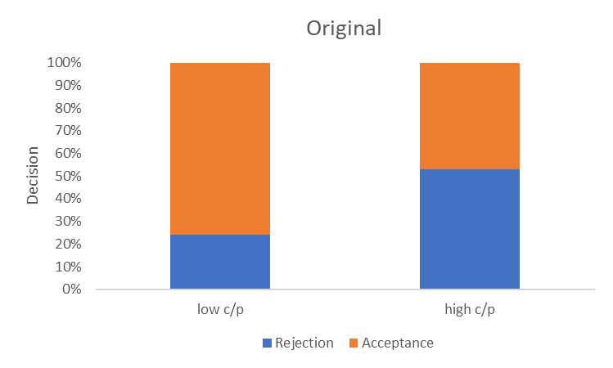
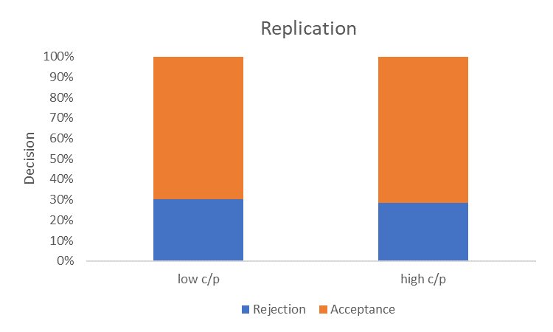
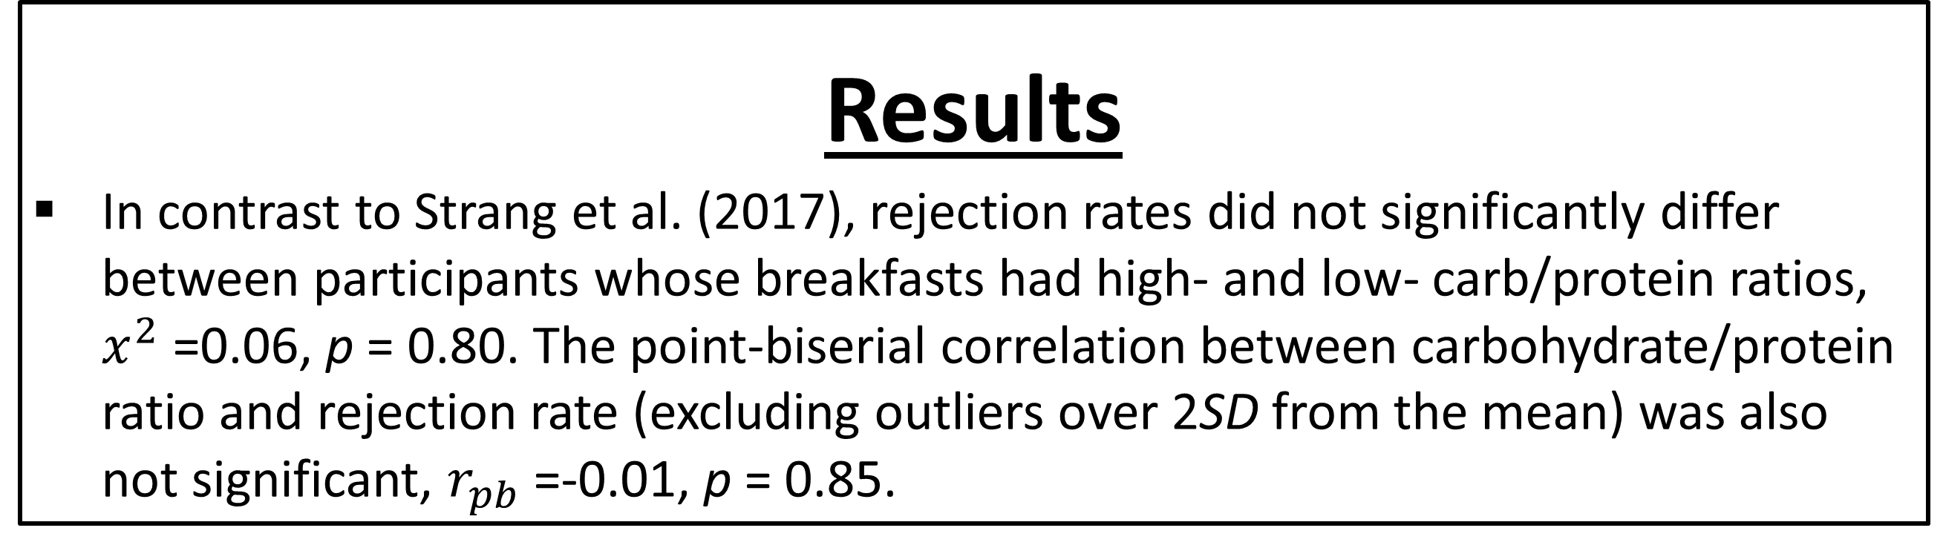
Impact of Nutrition on Social Decision Making: A Replication Attempt
Humayun B. Khan Abraham M. Rutchick
San Diego State University California State University, Northridge
Introduction
A recent paper (Strang et al., 2017, PNAS) described an effect wherein the carbohydrate/protein ratio of participants’ breakfast was significantly associated with their social punishment behaviors. The current study is an amply powered preregistered replication of that study.
Specifically, we sought to determine whether participants who ate a breakfast with a high carbohydrate/protein ratio would engage in more costly social punishment behaviors than those who ate a breakfast with a low carbohydrate/protein ratio.
The original study was conducted among German university students; the replication was conducted among United States college students.
People who ate a breakfast with a high carbohydrate/protein ratio did not exhibit increased social punishment behaviors, compared to people who ate a low carb/protein breakfast.
Discussion
The findings of Strang et al. (2017) were not replicated, despite the larger sample.
However, it is worth nothing that there were several differences in this replication.
There were several potential differences between the original and replication samples, including baseline rejection rates in the Ultimatum Game and different typical carbohydrate/protein ratios at breakfast.
The stakes in the original study may have seemed more realistic than in the replication.
The timing of the Ultimatum Game decision was slightly faster in the original study.
References
Nutritional Values For Common Foods And Products (2021, January 8).Nutrition value. https://www.nutritionvalue.org/
Strang, S., Hoeber, C., Uhl, O., Koletzko, B., Münte, T. F., Lehnert, H., … Park, S. Q. (2017). Impact of Nutrition on Social Decision Making. 114 (25), 6510-6514.
Method
Participants (n = 193) completed an online questionnaire in which they report, in detail, the breakfast they ate that day. They will then play a one-shot ultimatum game in which their partner makes an unfair offer.
The Ultimatum Game is a decision-making game played by 2 people(a proposer and a responder). One person proposes an offer from $1 to $10 to the other (the responder) and the responder decides to accept or reject the offer. If the offer is rejected, neither player receives money.
The responder was told that the previous participant previous participant chose to offer $2 and keep $8. We wanted to see how much more likely subjects are to punish an unfair deal, by observing their response to the unfair offer of $2.
Participants also submitted a detailed list of their breakfast on the morning that they took the survey. This was analyzed using nutritionvalue.org.
Results
In contrast to Strang et al. (2017), rejection rates did not significantly differ between participants whose breakfasts had high- and low- carb/protein ratios, $x^{2}$ =0.06, p = 0.80. The point-biserial correlation between carbohydrate/protein ratio and rejection rate (excluding outliers over 2SD from the mean) was also not significant, $r_{pb}$ =-0.01, p = 0.85.
Contact Information
hkhan1339@sdsu.edu
rutchick@csun.edu

